Slide 1
Checking and securing understanding of written addition and subtraction strategies
Arithmetic procedures with integers and decimals

Slide 2
how to use Oak lessons

Slide 3
I can generalise and fluently use written addition and subtraction strategies, including columnar formats, with decimals.

Slide 4
Metric units are based around the standard units of metre, gram and litre.
The additive inverse of a number is a number that, when added to the original number, gives the sum of 0.
The absolute value of a number is its distance from zero. E.g. 5 and (-5) are both 5 away from zero and so both have an absolute value of 5.

Slide 5

Checking and securing understanding of written addition and subtraction strategies
Checking addition & subtraction strategies
Working with values not measured in the same unit

Slide 6
Checking addition & subtraction strategies
What is the same and what is different about these sets of place value counters?
1
1
1
1
1
1
10
1
1
1
10
1
1
1
They both represent 23.
The one on the right has not exchanged the 10 ones for a ten.
10
1
1
10
1
1

Slide 7
Checking addition & subtraction strategies
What is the same and what is different about these sets of place value counters?
0.1
0.1
0.1
10
0.1
0.1
10
1
10
0.1
0.1
10
1
0.1
10
1
0.1
0.1
They both represent 32.1.
The one on the right has not exchanged the 10 tenths for a one.
10
1
0.1
0.1

Slide 8
Checking addition & subtraction strategies
Rewrite the following representation in its simplest form:
1
1
1
1
0.1
1
1
0.1
0.1
45.1
1
1
0.1
0.1
1
1
0.1
0.1
1
10
1
1
0.1
0.1
10
10
1
1
10
10
1
1
0.1
0.1
10
10
1
1
0.1

Slide 9
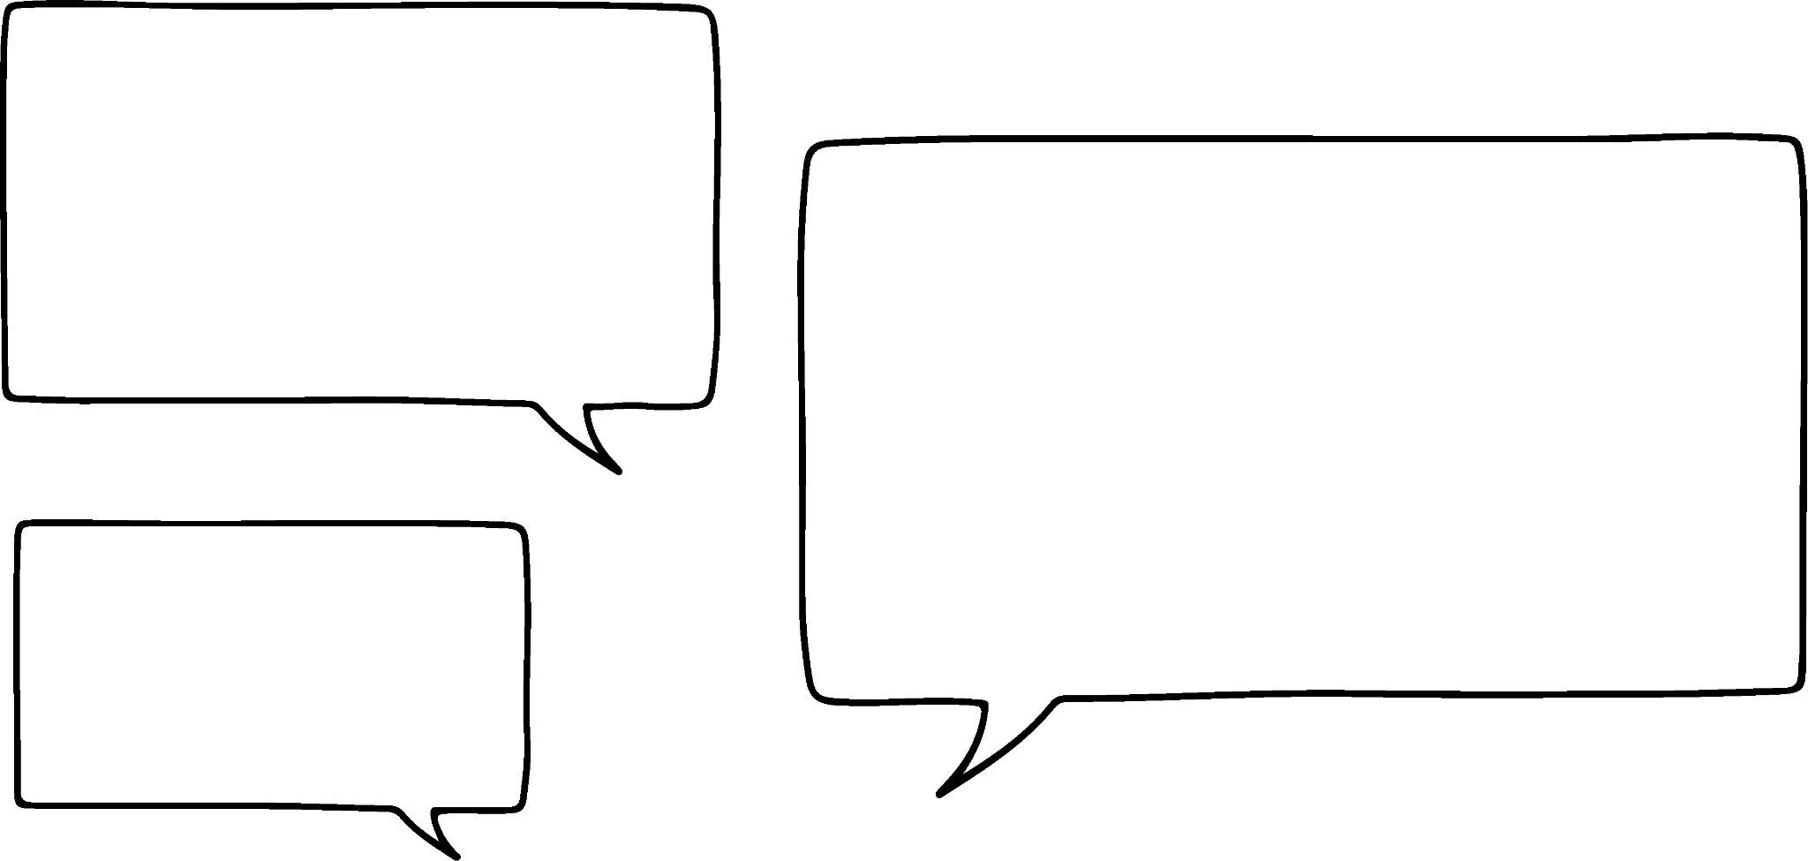


Checking addition & subtraction strategies
Aisha & Jacob have noticed that they can spend more money than they have on their accounts in the canteen.
They wonder if this can happen anywhere else.
I think this can happen with a bank account.
Oh, yes you are right. It’s called an overdraft.

Slide 10
Checking addition & subtraction strategies
A bank account has a balance of £75.00.
£134.95 is spent.
What is the new balance?
I thought the larger number always had to go on the top.
But then we wouldn’t be calculating £75.00 − £134.95
Here is the calculation.
It won’t matter.
75.00
− 134.95
Do you agree with Jacob?

Slide 11
Checking addition & subtraction strategies
A bank account has a balance of £75.00.
£134.95 is spent.
What is the new balance?
That cannot be right as you spent more than was in the account so you will have a negative balance.
0
1
2
1
1 3 4 . 9 5
− 7 5 . 0 0
.
5
9
9
5
Do you agree with Aisha?

Slide 12
Checking addition & subtraction strategies
A bank account has a balance of £75.00.
£134.95 is spent.
What is the new balance?
Rewrite as an equivalent addition
75 − 134.95
75 + (−134.95)
= (−59.95)
Additive inverses
(−75)
(−59.95)
The new balance is (−£59.95)

Slide 13
Checking addition & subtraction strategies
What is the same and what is different about Aisha’s & Jacob’s answers?
Aisha’s answer (−£59.95)
Jacob’s answer £59.95
Yes, you just have to remember that the answer will be negative because you are subtracting more money than you have.
So, my method gave the correct absolute value.

Slide 14
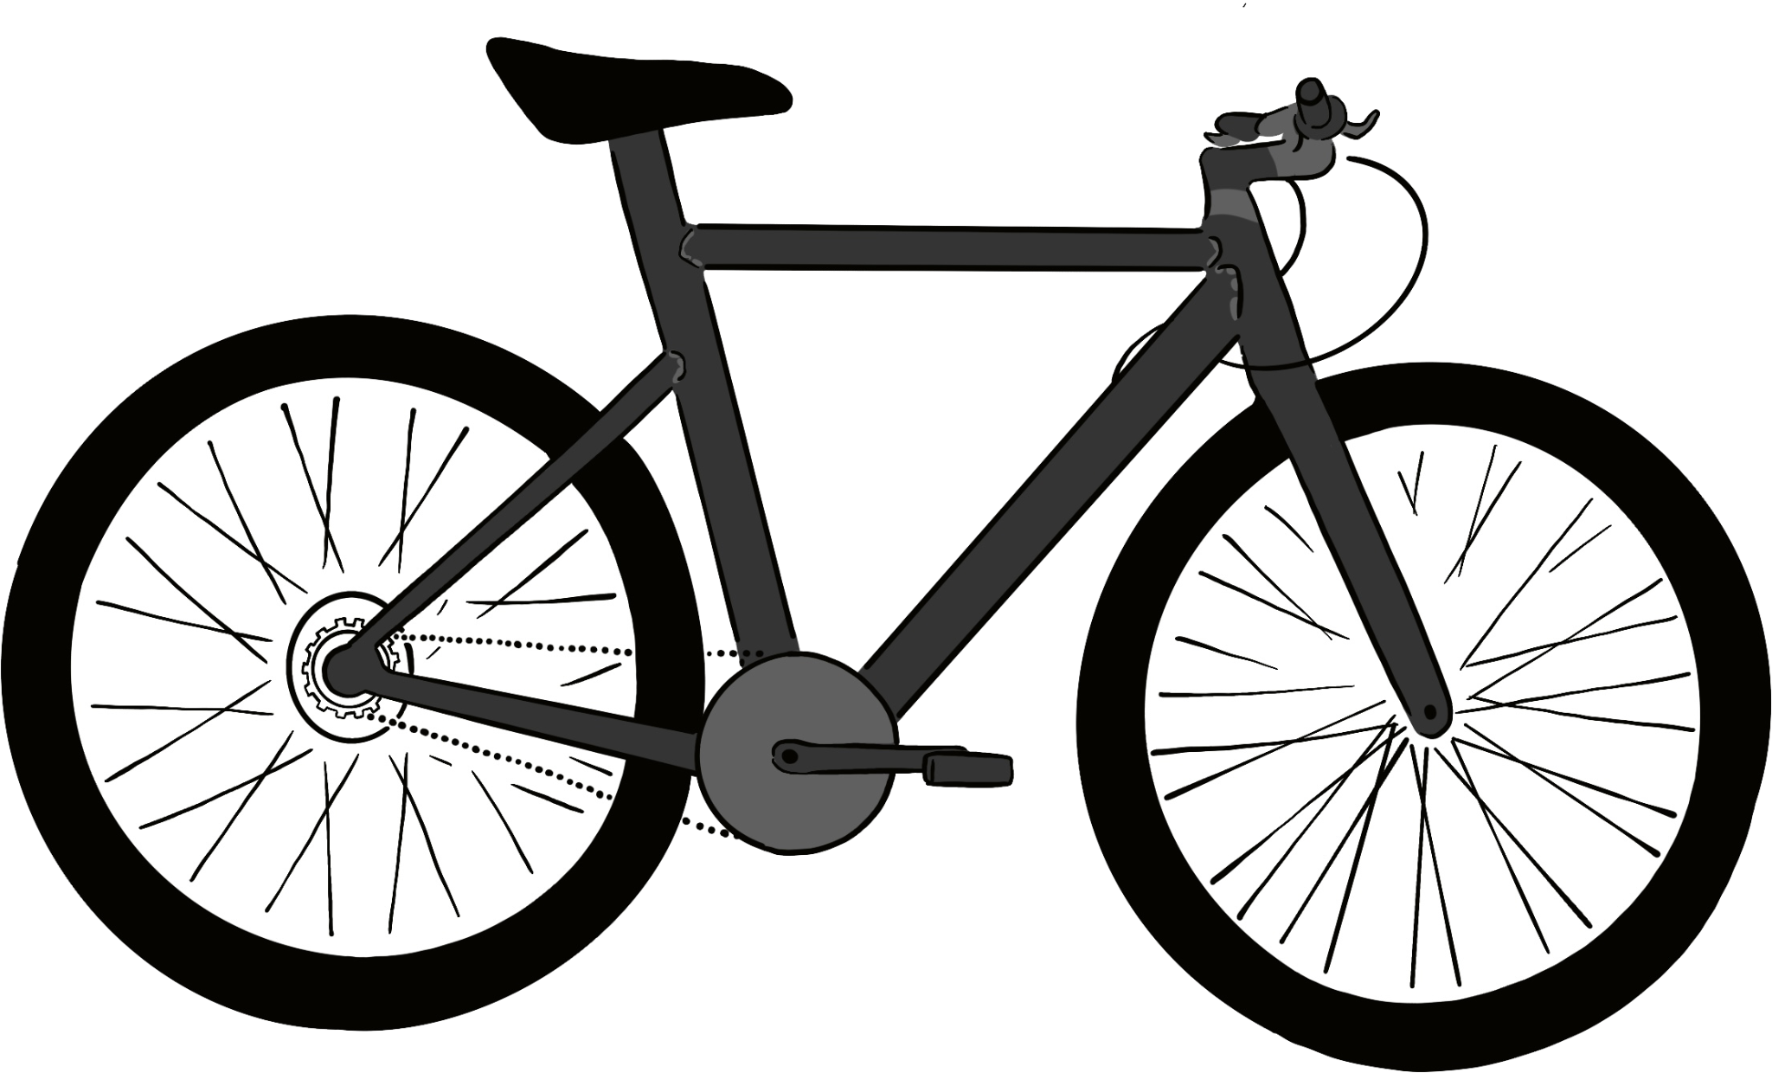
Checking addition & subtraction strategies
Account balance: £481.24
What will the new balance be if the bike is bought?
£575.75
Rewrite as an equivalent addition
481.24 − 575.75
481.24 + (−575.75)
= (−94.51)
1
4
5 7 5 . 7 5
− 4 8 1 . 2 4
.
Additive inverses
(−481.24)
(−94.51)
9
4
5
1
The new balance is (−£94.51)

Slide 15
Checking addition & subtraction strategies
Account balance: £150.88
What will the new balance be if the bike is bought?
£575.75
575.75
− 150.88
.
This is the absolute
value.
4
2
4
8
7
The new balance will be (−£424.87)

Slide 16
Checking addition & subtraction strategies
Work out the new balance for each account:
Current balance | Bought | New balance
£14 570 | Car
£18.75 | T-Shirt
£426.65 | Bike
£152.24 | Fridge
£356.87 | TV
£128.02 | Mobile Phone
£265.14 | Your choice of item(s)
Price List
Bike
Car
TV
Mobile Phone
T-Shirt
Fridge
£575.75
£15 650.00
£480.95
£355.65
£25.50
£289.99

Slide 17
Checking addition & subtraction strategies
Work out the new balance for each account:
Current balance | Bought | New balance
£14 570 | Car | (−£1080)
£18.75 | T-Shirt | (−£6.75)
£426.65 | Bike | (−£149.10)
£152.24 | Fridge | (−£137.75)
£356.87 | TV | (−£124.08)
£128.02 | Mobile Phone | (−£227.63)
£265.14 | Your choice of item(s) | e.g. (−£215.81)
Price List
Bike
Car
TV
Mobile Phone
T-Shirt
Fridge
£575.75
£15 650.00
£480.95
£355.65
£25.50
£289.99

Slide 18
Checking and securing understanding of written addition and subtraction strategies
Checking addition & subtraction strategies
Working with values not measured in the same unit

Slide 19
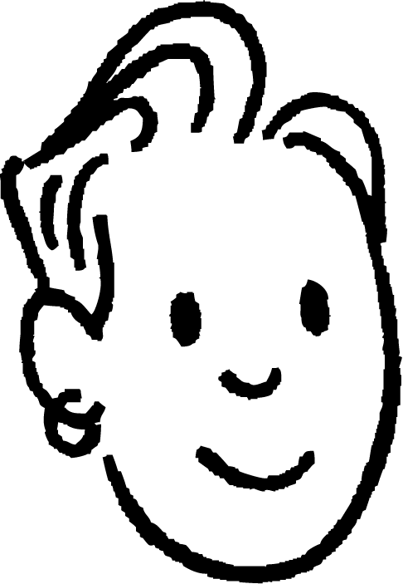


Working with values not measured in the same unit
Jun, Sam and Laura each measure the height of their sunflowers.
Mine is 2.26 m
Mine is 376 mm
Mine is 86.4 cm
What is the total height of their sunflowers?

Slide 20
Working with values not measured in the same unit
What is the total height of their sunflowers?
8 6 . 4 0
2 . 2 6
3 7 6 . 0 0
.
+
We should have changed them all into the same units before we added them.
4
6
4
6
6
1
1
I don’t know because we each used a different unit.
What units is our answer in?
Mine is 376 mm
Mine is 86.4 cm
Mine is 2.26 m

Slide 21
Working with values not measured in the same unit
They have decided to change all of their measurements into metres.
86.4 cm is 0.864 m
Mine is 86.4 cm
kilo |  |  | metres |  | centi | milli
 |  |  |  | 8 | 6 | 4
 |  |  | 0 | 8 | 6 | 4
describes greater length
describes smaller length

Slide 22
Working with values not measured in the same unit
They have decided to change all of their measurements into metres.
Mine is already in metres it is 2.26 m

Slide 23
Working with values not measured in the same unit
They have decided to change all of their measurements into metres.
Mine is 376 mm
376 mm is 0.376 m
kilo |  |  | metres |  | centi | milli
 |  |  |  | 3 | 7 | 6
 |  |  | 0 | 3 | 7 | 6
describes greater length
describes smaller length

Slide 24
Working with values not measured in the same unit
Now they can find the total height of their sunflowers.
Jun’s is 0.864 m
Sam’s is 2.26 m
Laura’s is 0.376 m
0 . 8 6 4
2 . 2 6 0
+ 0 . 3 7 6
.
3
5
0
0
1
2
1
What units is the answer in?
The total height of their sunflowers is 3.5 m.

Slide 25
Working with values not measured in the same unit
When working with values in different units, we must make sure we convert them all into the same units before working with them together.
Alex lives 2.3 km from school and Izzy lives 875m from school.
They both walk to school.
How much further does Alex walk?

Slide 26
Working with values not measured in the same unit
Alex lives 2.3 km
kilo |  |  | metres |  | centi | milli
2 | 3
2 | 3 | 0 | 0
describes greater length
describes smaller length
Alex lives 2300 m

Slide 27
Working with values not measured in the same unit
Alex lives 2300 m
Izzy lives 875m
1
9
1
2
1
1
2 3 0 0
− 8 7 5
1
4
2
5
Alex walks an extra 1425 m than Izzy.

Slide 28

Working with values not measured in the same unit
Find the total of 4.5 km, 1870 m and 782 cm.
Which if the correct calculation to find the total distance in metres?
450 + 1870 + 7.82
4.5 + 1.87 + 0.00782
4500 + 1870 + 7.82
4500 + 1870 + 0.782

Slide 29
Working with values not measured in the same unit
Fill in the missing values in this addition pyramid.
The sum of the 2 bricks below
520 m + 16.4 m
The sum of the 2 bricks below
1.26 m + 3.8 m
1589.06 m
528.86 m
1060.2 m
5.06 m
523.8 m
536.4 m
126 cm
3.8 m
0.52 km
16.4 m

Slide 30
Working with values not measured in the same unit
What value is in the missing brick?
The difference between 652.69 m and 245 cm
652.69 m
652.69 − 2.45 m
245 cm
m
650.24

Slide 31
Working with values not measured in the same unit
Complete the addition pyramids.
Each brick is the sum of the 2 bricks below it.
1)
2)
m
m
m
m
15.61 m
m
3.9 m
126 cm
0.05 km
10.4 m
cm
0.243 km
3)
4)
m
m
376.3 cm
57.76 m
12 810 cm
km
2.201 m
cm
m
m
5780 cm
466.2 m

Slide 32
Working with values not measured in the same unit
Complete the addition pyramids.
Each brick is the sum of the 2 bricks below it.
5)
m
cm
357.75 km
71.52 km
m
31 714 500 cm
m
3 696 000 cm
mm
313 500 m
560 000 mm
km
2960 m
cm
312.815 km

Slide 33
Working with values not measured in the same unit
Complete the addition pyramids.
Each brick is the sum of the 2 bricks below it.
1)
2)
56.42 m
263.82 m
5.16 m
51.26 m
15.61 m
248.21 m
3.9 m
126 cm
0.05 km
10.4 m
521 cm
0.243 km
3)
4)
61.523 m
652.1 m
376.3 cm
57.76 m
12 810 cm
0.524 km
2.201 m
156.2 cm
56.198 m
70.3 m
5780 cm
466.2 m

Slide 34
Working with values not measured in the same unit
Complete the addition pyramids.
Each brick is the sum of the 2 bricks below it.
5)
469 875 m
11 212 500 cm
357.75 km
71.52 km
40 605 m
31 714 500 cm
34 560 m
3 696 000 cm
3 645 000 mm
313 500 m
560 000 mm
34 km
2960 m
68 500 cm
312.815 km

Slide 35
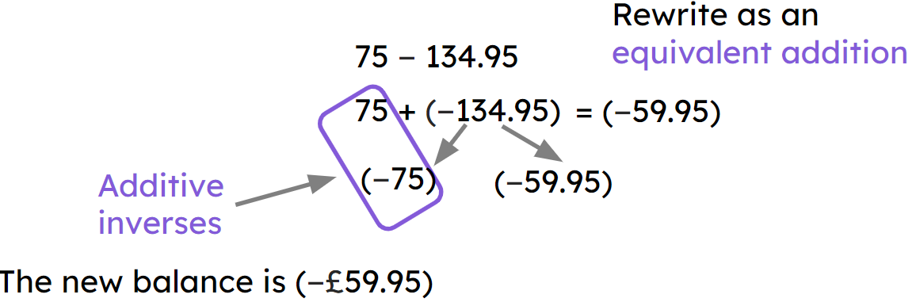
Checking and securing understanding of written addition and subtraction strategies
Any subtraction can be rewritten as an addition using additive inverses.
E.g.
When working with decimals, the decimal point helps to ensure digits with the same place value are combined.
Numbers in different units must be changed into the same units before combining.

Slide 36

© Oak National Academy 2023.
Produced in partnership with Mathematics in Education and Industry.
Licensed on the Open Government Licence v3.0, except where otherwise stated. See Oak terms and conditions.

